Slide 2
Our Speakers
Mufti Mohammed Abrarul Haq, is a senior lecturer at Darululoom Chicago (an Islamic seminary where students become Islamic scholars) and the Assistant to the National Director of Halal Monitoring Services of Shariah Board of America. He has extensive educational and teaching background spanning over the past 25+ years and 3 continents.
Muhammad Khan, is a volunteer inspector in Halal Monitoring Services with a background in Information Technology and Management Consulting. Mr. Muhammad Khan has experience in community outreach, inspection and monitoring strategy and training

Slide 3
What is HMS?
Halal Monitoring Services (HMS) is a branch of Shariah Board of America (founded in 1998) a division of Rahmat-e-Alam Foundation
Headquarters in Chicago with presence currently in 23 states
Certifies and monitors a total of 240+ Slaughter Houses, Processors, Distributors, Meat Shops, Restaurants etc. across 23 states (and Canada) as of 07/18/22
Free of cost service for the benefit of the community
All meat and poultry fulfills the requirements of a Muslim Slaughterer slaughtering each animal or bird by hand reciting Tasmiyyah (blessing) on each animal or bird individually

Slide 4
What is HMS?
Ingredients of further processed and/or cooked foods in certified establishments are verified
Monitoring means ongoing random / unannounced inspections
Decision making process for certification / non-certification is in the hands of a team of Islamic scholars (called ulama and muftis)
End-to-End certification and supply chain monitoring

Slide 5
FREE OF COST
SUPPLYCHAIN CERTIFICATION & MONITORING

Slide 6
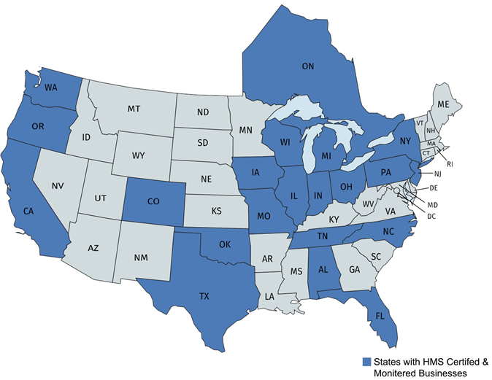
HMS CURRENT FOOTSTEPS
As of 07/18/22
Slaughter Houses, Processors & Distributors: 68 | Meat Shops: 76 | Restaurants & Others: 100

Slide 7
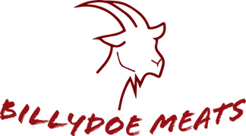
FEW OF THE HMS CERTIFIED ENTITIES
Lamb Only
Lamb Only
Lamb & Limited Veal
As of 07/18/22

Slide 8
Requirements of Halal Slaughter
Slaughterman has to be a Sunni Muslim
Has to recite tasmiyyah (blessing) on each animal or bird individually while slaughtering
Upon slaughtering the 4 veins, arteries and passageways should all be severed
Animal or bird should not be touched until after it has bled to death, in other words no processing can start until that time

Slide 9
Certification Process for Slaughter Houses & Processors
Fill out and submit the application to halalzabiha@rahmatealam.org from https://shariahboard.org/downloads
Depending upon the production volume of birds or animals, at least one main and one backup Muslim slaughterman should be hired by the slaughter house
HMS performs an initial inspection to verify the procedure followed by the slaughtermen
HMS provides services to train the slaughterman as needed
Upon fulfillment of the requirements of Halal Slaughter the application is approved and monitoring is started

Slide 10
Certification Process for Further Processors
Fill out and submit the application to halalzabiha@rahmatealam.org from https://shariahboard.org/downloads
In order to produce further processed products (e.g. hot dogs, gyros etc.) not only the meat and poultry has to be sourced from an HMS certified slaughter house but, the processing facility should ensure strict cleaning and segregation procedures to avoid any cross contamination of Halal with non-Halal products

Slide 11
Ongoing Monitoring
Ongoing monitoring is a combination of unannounced periodic in person inspections of the facility and one or more of the following:
Informing HMS of the slaughtering and/or production schedule (and any changes to it) on an ongoing basis
Filling out of a weekly report template where the slaughter house endorses nothing significant has been changed in the process including removal or addition of slaughterman
Periodic video conferences with the slaughterman and other responsible parties as needed
For further processors, for each production run the plant has to document and submit a production report before the product is sold

Slide 12
Q&A

